Slide 1
RateMyProfessor Regression
CSC 635
Final Project Presentation
Authors:
Sam Nack
Sharmin Sultana

Slide 2
Introduction
RateMyProfessor is a website where students can leave reviews for professors
https://www.ratemyprofessors.com/
Its helps students to research which professor they would like to take based on the experiences of their peers.
We are wanting to create a regression model to calculate the professor rating based on certain key aspects of their reviews on the site.

Slide 3
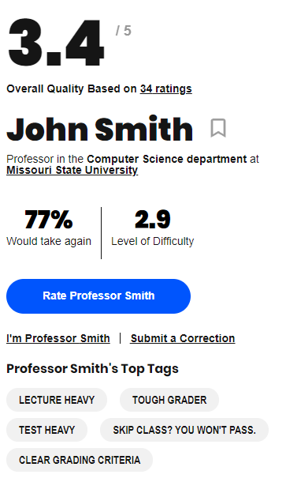
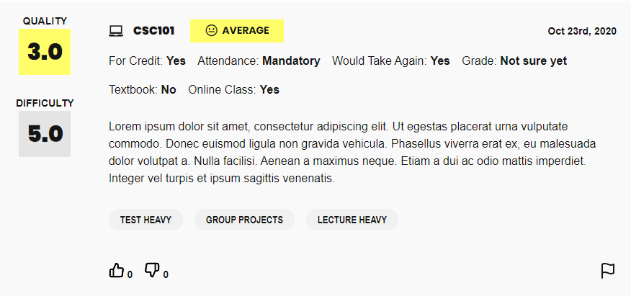
Rate My Professor Site
The overall quality rating (star rating) will be our regression target
We will be using the top tags as our features
There are 21 tags students can use, most popular are listed as top tags

Slide 4
Rate My Professor Dataset
Dr. Jibo He
https://data.mendeley.com/datasets/fvtfjyvw7d/2
20,000 records of student reviews in a csv file
51 Features
We will only be using the professor’s star rating and the 21 features corresponding to the top tags.

Slide 5
Preprocessing Dataset
We load the csv into a dataframe using pandas
We perform some preliminary analysis
Group all of a professor’s ratings together
Find the average star_rating
Drop unnecessary columns
Rescale star_rating to range [0,1]
Split dataset into training and testing

Slide 6
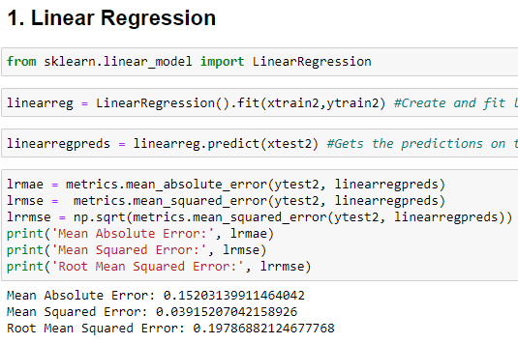
Linear Regression
Estimate relationship between two quantitative variables
Multiple linear regression, uses several explanatory variables to predict the outcome of a response variable.

Slide 7
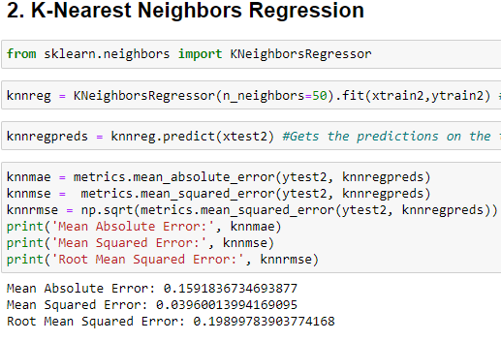
K-Nearest Neighbours Regression
Initialize K which defines the chosen number of neighbours
Group K members by calculating ‘feature similarity based on distances’ to predict the values of any new data points.

Slide 8
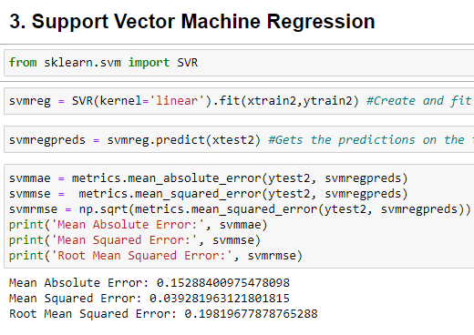
Support Vector Regression
aims to fit the best line within a threshold value rather than minimizing the error between the real and predicted value.
straight line is known as hyperplane and the nearest data points on either side of the hyperplane are termed Support Vectors.

Slide 9
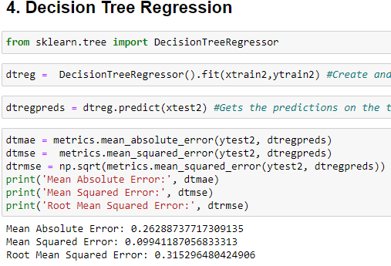
Decision Tree Regression
cuts down a dataset into smaller and smaller sections while also developing an associated decision tree.
homogeneity of a numerical sample is calculated by using Standard Deviation.

Slide 10
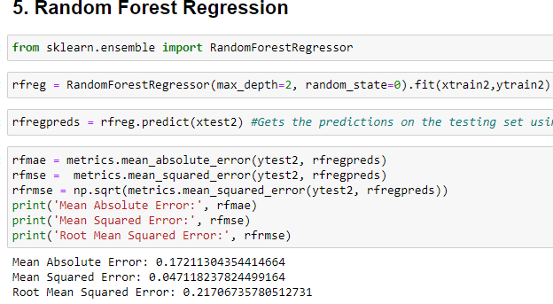
Random Forest Regression
The trees in random forests are run in parallel.
No interaction between trees while building the trees.
Fits a number of classifying decision trees on various sub-samples of the dataset and uses averaging to improve the predictive accuracy and control over-fitting.

Slide 11
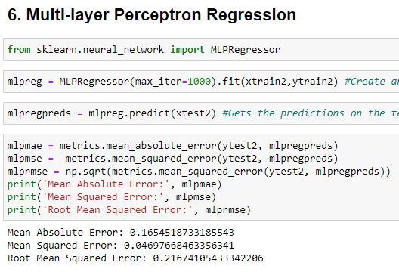
Multi-layer Perceptron Regression
Neural Network based algorithm.
At first, generate (n+1) random weights and calculated weighted sum for each input values.
For each sample, calculate error and update weights for a certain number of iterations.
After that set a threshold value to make a decision.

Slide 12
Code Demo
We used a Jupyter Notebook which I will now demonstrate

Slide 13
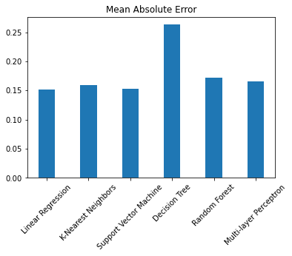
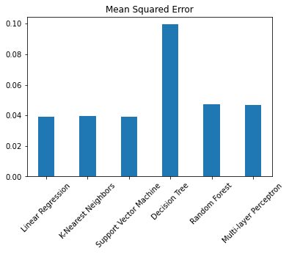
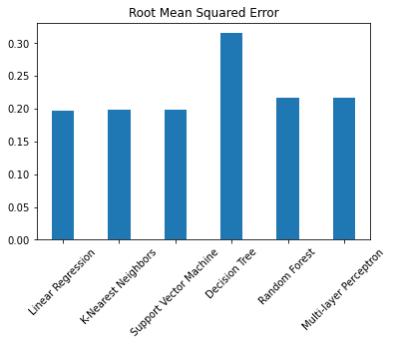
Results

Slide 14
Conclusion
Decision Tree performed the worst
SVM and Linear Regression performed best
In future work, more focus could be given to these two algorithms to further improve their scores.

